Slide 1
Statistical Methods for Decision Making

Slide 2
Agenda:
Theory of Estimation
A. Point Estimation
B. Interval Estimation
2. Hypothesis Testing
A. Terminology
B. Errors in Hypothesis Testing
C.One tail & Two tail tests

Slide 3
Estimation

Slide 4
Estimation
Estimation is part of life.
Before crossing a street, you estimate the speed of any car that is approaching.
Distance between you and that car, and your own speed is roughly calculated.
Having made these quick estimate you decide whether to wait, walk or run.
You know that the speed you estimated is not exact but allow for a margin of error to be safe while crossing.

Slide 5
Estimator
Any sample statistics that is used to estimate a population parameter is called an estimator.

Slide 6
Point Estimation
Sample
Compute Statistic. The statistic is the point estimator of Population parameter
Population

Slide 7
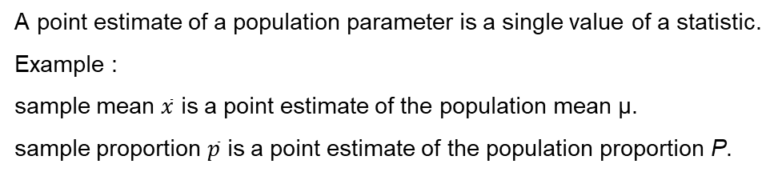
Point Estimation
A point estimate of a population parameter is a single value of a statistic.
Example :
sample mean $\overline{x}$ is a point estimate of the population mean μ.
sample proportion $\overline{p}$ is a point estimate of the population proportion P.

Slide 8
Point Estimation
Parameters are numbers that summarize data for an entire population.
This means the parameter tells us something about the whole population.
It is any numerical quantity that characterizes a given population
Statistics are numbers that summarize data from a sample, i.e. some subset of the entire population.

Slide 9
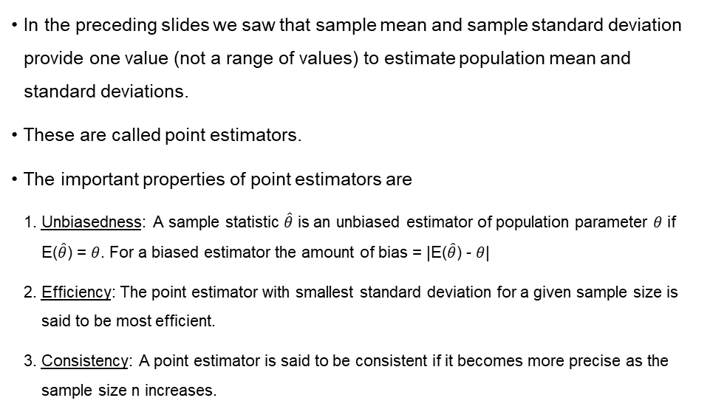
Criteria of a Good Estimator
In the preceding slides we saw that sample mean and sample standard deviation provide one value (not a range of values) to estimate population mean and standard deviations.
These are called point estimators.
The important properties of point estimators are
Unbiasedness: A sample statistic $\hat{θ}$ is an unbiased estimator of population parameter $θ$ if E($\hat{θ}$) = $θ$. For a biased estimator the amount of bias = |E($\hat{θ}$) - $θ$|
Efficiency: The point estimator with smallest standard deviation for a given sample size is said to be most efficient.
Consistency: A point estimator is said to be consistent if it becomes more precise as the sample size n increases.

Slide 10
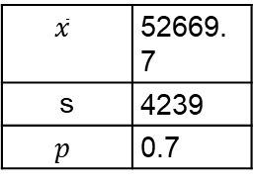
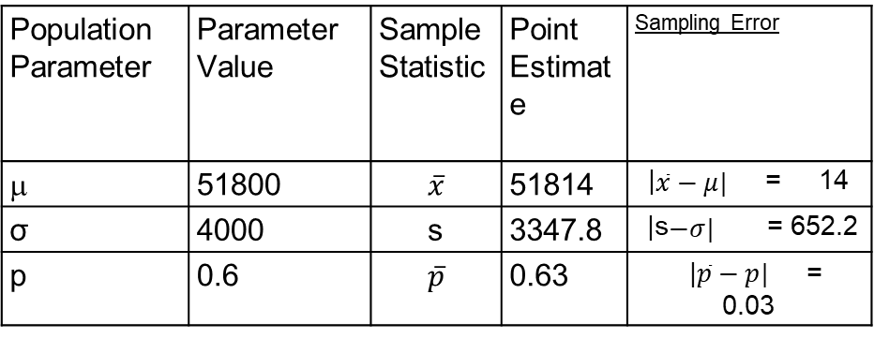
Point Estimation Table
Population Parameter | Parameter Value | Sample Statistic | Point Estimate | Sampling Error
μ | 51800 | $$\overline{x}$$ | 51814 | |$\overline{x}−μ|$ = 14
σ | 4000 | s | 3347.8 | |s$−σ|$ = 652.2
p | 0.6 | $$\overline{p}$$ | 0.63 | |$\overline{p}−p|$ = 0.03
Sample 2:
$$\overline{x}$$ | 52669.7
s | 4239
$$p$$ | 0.7
Try to find out the Sampling Error for Sample 2 to estimate the Population parameter mentioned before.

Slide 11
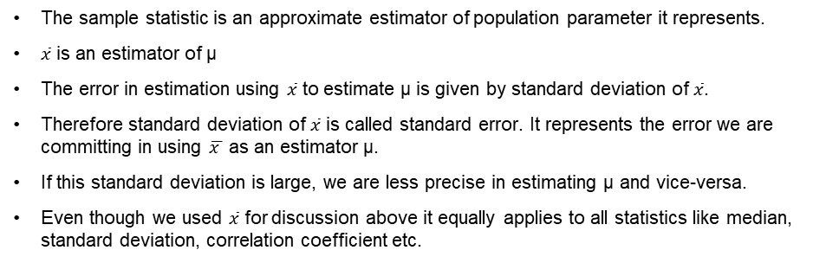
Standard Error
The sample statistic is an approximate estimator of population parameter it represents.
$\overline{x}$ is an estimator of μ
The error in estimation using $\overline{x}$ to estimate μ is given by standard deviation of $\overline{x}$.
Therefore standard deviation of $\overline{x}$ is called standard error. It represents the error we are committing in using $\overline{x }$ as an estimator μ.
If this standard deviation is large, we are less precise in estimating μ and vice-versa.
Even though we used $\overline{x}$ for discussion above it equally applies to all statistics like median, standard deviation, correlation coefficient etc.

Slide 12

Standard Error
Standard Error is a method of measurement or estimation of standard deviation of population distribution associated with an estimation method.
Observations = (10,20,30,40,50) No. Of Obs = 5
Mean (x_{m}) = 30
SD = 15.811
Standard Error = SD/ √(N) Standard Error = 15.811/√(5) Standard Error = 7.071

Slide 13
Interval Estimation
An interval estimate is defined by two numbers.
Interval within which a population parameter is very likely to lie.
Example, a < µ < b is an interval estimate of the population mean μ.
It indicates that the population mean is greater than ’a’ but less than ’b’.

Slide 14
Confidence Interval
Statisticians use a confidence interval to express the precision and uncertainty associated with a given sampling method. A confidence interval consists of three parts.
A confidence level.
A statistic (Mean or Proportion)
A margin of error.

Slide 15
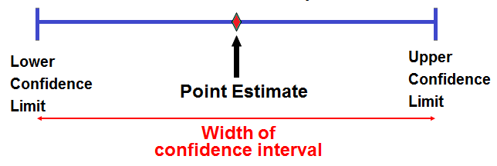
Confidence Interval

Slide 16

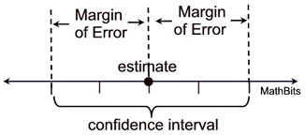
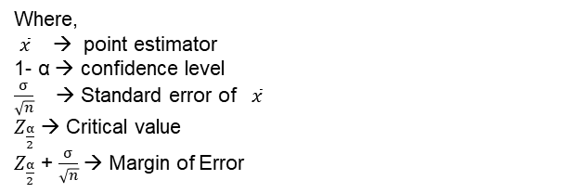
Confidence Level
Confidence levels are used when two sets of data are being compared.
A confidence level is the likelihood of obtaining a particular result by chance rather than due to a truly significant difference in the two sets of data.
A confidence interval addresses this issue because it provides a range of values which is likely to contain the population parameter of interest.
A 95% confidence interval means that there is a 95% chance that the confidence interval contains the population mean.
Where,
$\overline{x}$→ point estimator
1- α → confidence level
$\frac{σ}{\sqrt{n}}$ → Standard error of $\overline{x}$
$Z_{\frac{α}{2}}$ → Critical value
$Z_{\frac{α}{2}}$ + $\frac{σ}{\sqrt{n}}$ → Margin of Error

Slide 17
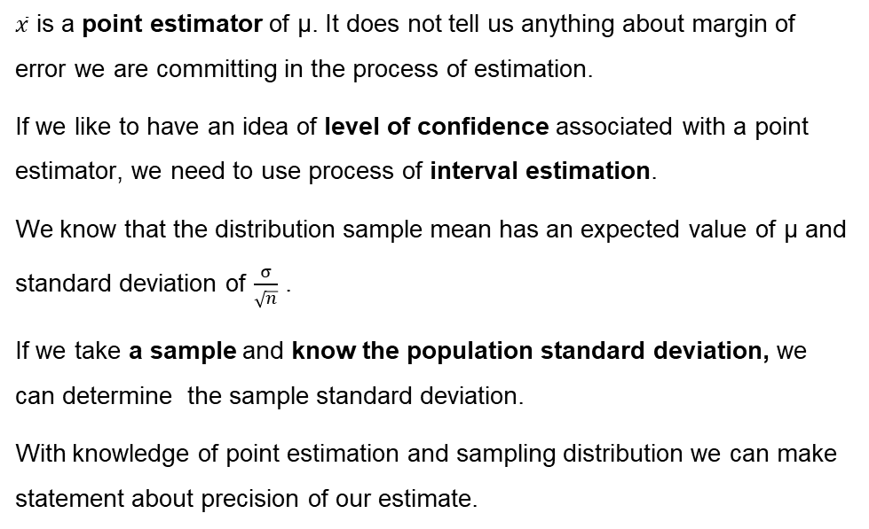
Interval estimation of Population Mean
$\overline{x}$ is a point estimator of μ. It does not tell us anything about margin of error we are committing in the process of estimation.
If we like to have an idea of level of confidence associated with a point estimator, we need to use process of interval estimation.
We know that the distribution sample mean has an expected value of μ and standard deviation of $\frac{σ}{\sqrt{n}}$ .
If we take a sample and know the population standard deviation, we can determine the sample standard deviation.
With knowledge of point estimation and sampling distribution we can make statement about precision of our estimate.

Slide 18
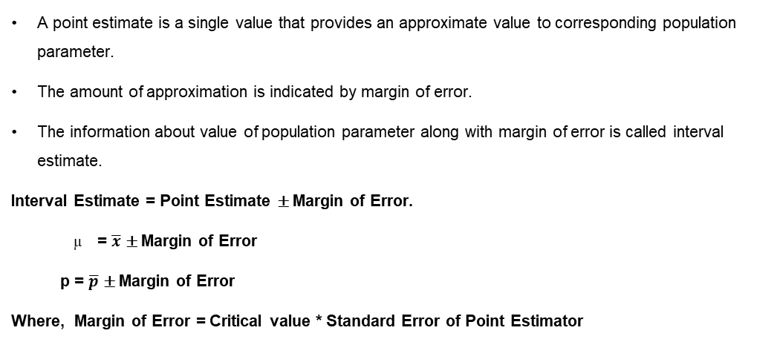
Interval Estimation of Population Mean
A point estimate is a single value that provides an approximate value to corresponding population parameter.
The amount of approximation is indicated by margin of error.
The information about value of population parameter along with margin of error is called interval estimate.
Interval Estimate = Point Estimate ± Margin of Error.
= $\overline{x}$ ± Margin of Error
p = $\overline{p}$ ± Margin of Error
Where, Margin of Error = Critical value * Standard Error of Point Estimator

Slide 19
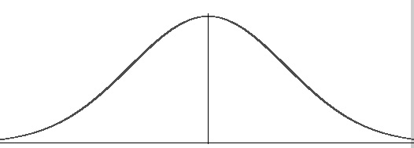
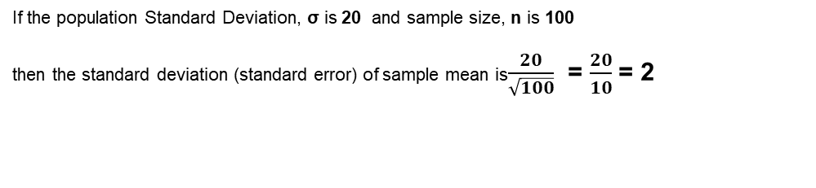



Interval Estimation
Sampling Distribution of $\overline{x}$
Standard deviation = $\frac{σ}{\sqrt{n}}$
μ
$$\overline{x}$$
mean
If the population Standard Deviation, σ is 20 and sample size, n is 100
then the standard deviation (standard error) of sample mean is$\frac{20}{\sqrt{100}}$ = $\frac{20}{10}$ = 2

Slide 20
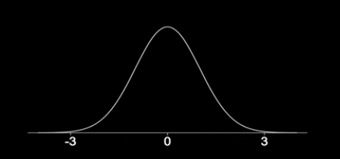
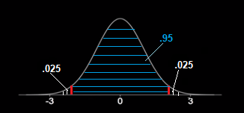
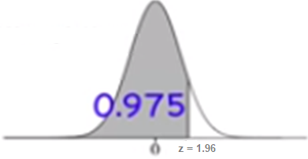
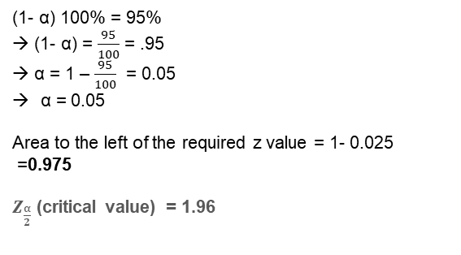


Calculate Confidence Coefficient for a given CI
What is the approximate z value for a 95% confidence Interval ?
= 1 - α
$\frac{α}{2}$ =
= $\frac{α}{2}$
(1- α) 100% = 95%
→ (1- α) = $\frac{95}{100}$ = .95
→ α = 1 – $\frac{95}{100}$ = 0.05
α = 0.05
Area to the left of the required z value = 1- 0.025
=0.975
$Z_{\frac{α}{2}}$ (critical value) = 1.96

Slide 21
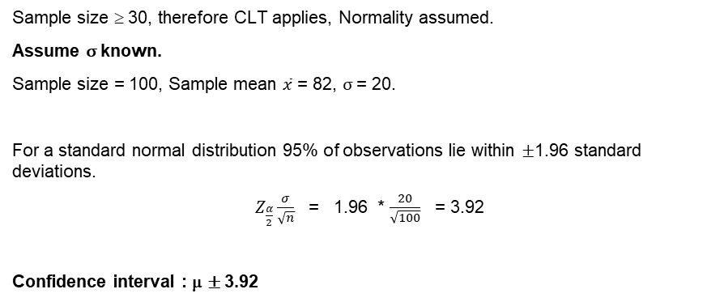
Interval Estimation for Population Mean – Large Sample
Sample size ≥ 30, therefore CLT applies, Normality assumed.
Assume σ known.
Sample size = 100, Sample mean $\overline{x}$ = 82, σ = 20.
For a standard normal distribution 95% of observations lie within ±1.96 standard deviations.
$Z_{\frac{α}{2}}\frac{σ}{\sqrt{n}}$ = 1.96 * $\frac{20}{\sqrt{100}}$ = 3.92
Confidence interval : μ ± 3.92

Slide 22
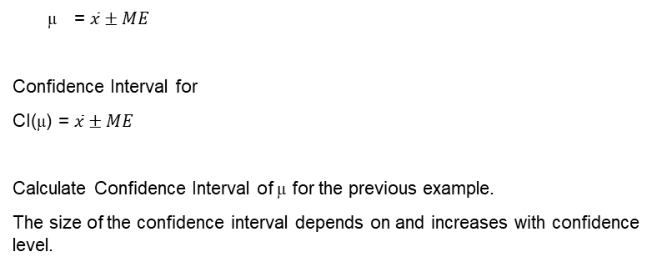
Confidence Interval for μ
= $\overline{x}±ME$
Confidence Interval for
CI(μ) = $\overline{x}±ME$
Calculate Confidence Interval of μ for the previous example.
The size of the confidence interval depends on and increases with confidence level.

Slide 23
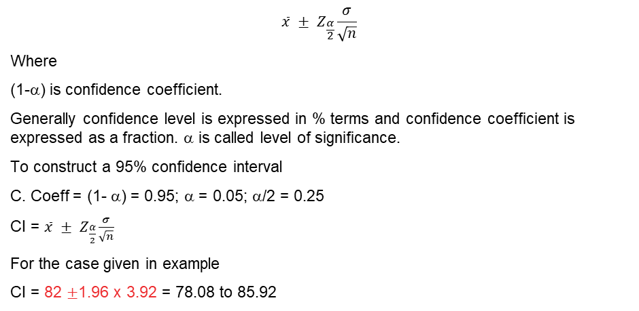
Interval Estimate for Population Mean (n ≥ 30)
$$\overline{x} ± Z_{\frac{α}{2}}\frac{σ}{\sqrt{n}}$$
Where
(1-α) is confidence coefficient.
Generally confidence level is expressed in % terms and confidence coefficient is expressed as a fraction. α is called level of significance.
To construct a 95% confidence interval
C. Coeff = (1- α) = 0.95; α = 0.05; α/2 = 0.25
CI = $\overline{x} ± Z_{\frac{α}{2}}\frac{σ}{\sqrt{n}}$
For the case given in example
CI = 82 ±1.96 x 3.92 = 78.08 to 85.92
When σ is Unknown Use s to Estimate σ

Slide 24

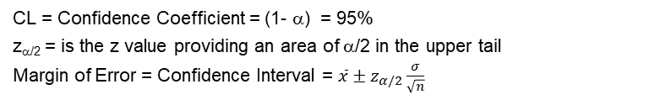

Interval Estimation of Population Mean
CL = Confidence Coefficient = (1- α) = 95%
z_{α/2} = is the z value providing an area of α/2 in the upper tail
Margin of Error = Confidence Interval = $\overline{x}±z_{α/2}\frac{σ}{\sqrt{n}}$
α/2
$$0$$
$$z$$
Confidence Level | α | α/2 | Z_{α/2}
90% | 0.10 | 0.05 | 1.645
95% | 0.05 | 0.025 | 1.960
99% | 0.01 | 0.005 | 2.576

Slide 25
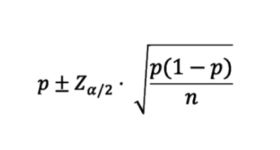
Interval estimation for Population Proportion
The theory behind a confidence interval of proportion is the same as that for a mean
Each element in the population can be considered as success or failure
Means and proportions are equivalent, except that proportion data is limited to binary values (1s and 0s)

Slide 26
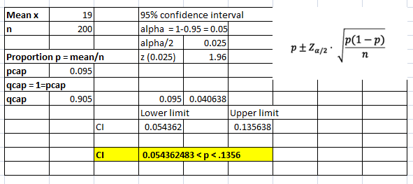
Estimating Population Proportion
A semi conductor manufacturer producers controllers used in automobile engine app. On random sample of 200 devices, found 19 are defective. Construct 95% confidence Interval around the true proportion defective
Solution :
(p) = 19/200 = 0.095
1-p = 1- 0.095 = .905

Slide 27
Interval Estimation for small Sample
Small Sample Cases: T- Distribution
When s is used to estimate σ, the margin of error and the interval estimate for the population mean are based on a probability distribution known as the t distribution.
When we have a sample of size < 30 and population standard deviation is unknown, in order to estimate population mean we use student “t” distribution with n-1 degrees of freedom.
Interval estimate of a population mean: σ Unknown

Slide 28
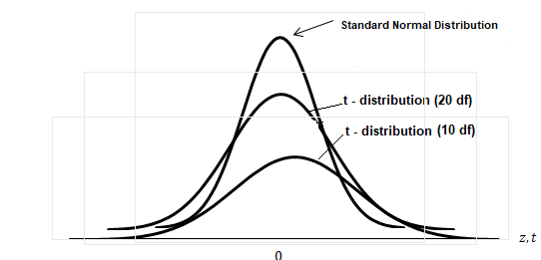
Small Sample Cases T- Distribution
When we have a sample of size < 30, population follows normal distribution and standard deviation is unknown, in order to estimate population mean we use student “t” distribution with n-1 degrees of freedom.

Slide 29
T- Distribution Table
Degrees of Freedom | Area in Upper Tail
 | .2 | .1 | .05 | .025 | .01 | .05
1 | 1.3764 | 3.0777 | 6.3138 | 12.7062 | 31.8205 | 6.3138
2 | 1.0607 | 1.8856 | 2.9200 | 4.3027 | 6.9646 | 2.9200
3 | .9785 | 1.6377 | 2.3534 | 3.1824 | 4.5407 | 2.3534
4 | .9410 | 1.5332 | 2.1318 | 2.7764 | 3.7469 | 2.1318
5 | .9195 | 1.4759 | 2.0150 | 2.5706 | 3.3649 | 2.0150
6 | .9057 | 1.4398 | 1.9432 | 2.4469 | 3.1427 | 1.9432
7 | .8960 | 1.4149 | 1.8946 | 2.3646 | 2.9980 | 1.8946
8 | .8889 | 1.3968 | 1.8595 | 2.3060 | 2.8965 | 1.8595
9 | .8834 | 1.3830 | 1.8331 | 2.2622 | 2.8214 | 1.8331
10 | .8791 | 1.3722 | 1.8125 | 2.2281 | 2.7638 | 1.8125
11 | .8755 | 1.3634 | 1.7959 | 2.2010 | 2.7181 | 1.7959
12 | .8726 | 1.3562 | 1.7823 | 2.1788 | 2.6810 | 1.7823
13 | .8702 | 1.3502 | 1.7709 | 2.1604 | 2.6503 | 1.7709
14 | .8681 | 1.3450 | 1.7613 | 2.1448 | 2.6245 | 1.7613
15 | .8662 | 1.3406 | 1.7531 | 2.1314 | 2.6025 | 1.7531

Slide 30
T- Distribution Table
Degrees of Freedom | Area in Upper Tail
 | .2 | .1 | .05 | .025 | .01 | .05
16 | .8647 | 1.3368 | 1.7459 | 2.1199 | 2.5835 | 1.7459
17 | .8633 | 1.3334 | 1.7396 | 2.1098 | 2.5669 | 1.7396
18 | .8620 | 1.3304 | 1.7341 | 2.1009 | 2.5524 | 1.7341
19 | .8610 | 1.3277 | 1.7291 | 2.0930 | 2.5395 | 1.7291
20 | .8600 | 1.3253 | 1.7247 | 2.0860 | 2.5280 | 1.7247
21 | .8591 | 1.3232 | 1.7207 | 2.0796 | 2.5176 | 1.7207
22 | .8583 | 1.3212 | 1.7171 | 2.0739 | 2.5083 | 1.7171
23 | .8575 | 1.3195 | 1.7139 | 2.0687 | 2.4999 | 1.7139
24 | .8569 | 1.3178 | 1.7109 | 2.0639 | 2.4922 | 1.7109
25 | .8562 | 1.3163 | 1.7081 | 2.0595 | 2.4851 | 1.7081
26 | .8557 | 1.3150 | 1.7056 | 2.0555 | 2.4786 | 1.7056
27 | .8551 | 1.3137 | 1.7033 | 2.0518 | 2.4727 | 1.7033
28 | .8546 | 1.3125 | 1.7011 | 2.0484 | 2.4671 | 1.7011
29 | .8542 | 1.3114 | 1.6991 | 2.0452 | 2.4620 | 1.6991
30 | .8538 | 1.3104 | 1.6973 | 2.0423 | 2.4573 | 1.6973

Slide 31
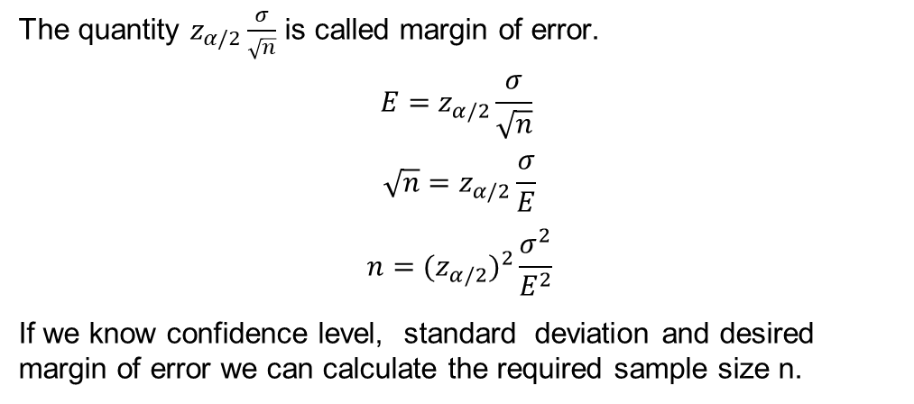
Sample Size Determination
The quantity $z_{α/2}\frac{σ}{\sqrt{n}}$ is called margin of error.
$$E=z_{α/2}\frac{σ}{\sqrt{n}}$$
$$\sqrt{n}=z_{α/2}\frac{σ}{E}$$
$$n={{(z}_{α/2})}^{2}\frac{σ^{2}}{E^{2}}$$
If we know confidence level, standard deviation and desired margin of error we can calculate the required sample size n.

Slide 32
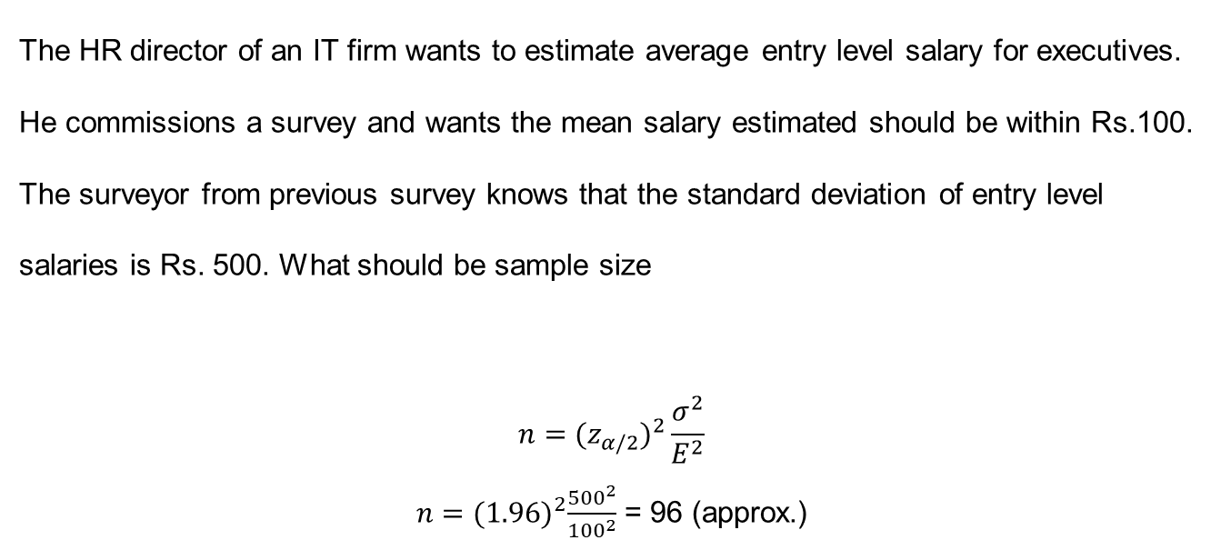
Sample Size Determination
The HR director of an IT firm wants to estimate average entry level salary for executives. He commissions a survey and wants the mean salary estimated should be within Rs.100. The surveyor from previous survey knows that the standard deviation of entry level salaries is Rs. 500. What should be sample size
$$n={{(z}_{α/2})}^{2}\frac{σ^{2}}{E^{2}}$$
$n={(1.96)}^{2}\frac{{500}^{2}}{{100}^{2}}$ = 96 (approx.)

Slide 33
Interval Estimation Procedure
Is n >= 30?
Yes
No
Is population normal?
Is σ known?
Yes
No
Yes
No
Is σ known?
Yes
No
Use the s to estimate σ
Use the s to estimate σ
Use
Use
Use
Use
Increase sample size to 30

Slide 34
Hypothesis Testing

Slide 35
Hypothesis
A hypothesis is a testable statement about something in the world around you.
It should be capable of being tested, either by experiment or observation.
Example :
A new medicine you think might work.
A way of teaching you think might be better.

Slide 36
Hypothesis
A hypothesis is statement made in support of a finding or a claim. This statement should to be tested for its statistical validity.
Examples of Hypothesis :
The new engine developed by R & D gives more mileage than existing engine.
It is suspected that a soft drink producer is under-filling the cans.
The Ah rating of batteries supplied by the sub-contractor is different from specified 12 hours.
It is natural that an odd engine, can or battery might have conformed to above statements and the analyst has to statistically prove that above finding or claim is supported by data.

Slide 37
Hypothesis Testing
Hypothesis testing in statistics is a way for you to test the results of a survey or experiment.
Hypothesis testing is an objective scientific method that is used in making statistical decisions using observational or experimental data.
Hypothesis Testing is basically
An assumption that we make about the population parameter.
A premise or claim that we want to test.
Example: Next Slide.

Slide 38
Hypothesis Testing Statement
Police department claims that the newly introduced traffic rules have substantially decreased deaths due to road accidents. Historically annual deaths due to road accidents have been 1234.
Statement
Number of accidents have decreased after the introduction of new traffic rules by the police.
Population Mean 1234.
Hypothesis Testing is basically
an assumption that we make about the population parameter. We assume that new population mean is different from 1234.
We want to analyze new data (sample) to validate the claim by police.

Slide 39
Types of Hypothesis : Null Hypothesis H₀
Null Hypothesis states that there is no real effect. What is observed is due to variation caused by uncontrolled variation inherent in the system. Null Hypothesis is denoted by H₀.
Example :
Special training on student has no effect.
Different teaching method has no effect on students’ performance
Drug used for headache has no effect after application.
In all the above statements, the null hypothesis assumes that perceived difference is due to natural variation in data.

Slide 40
Types of Hypothesis: Alternate Hypothesis H_{a}
Alternate hypothesis. This is the fact we are trying to prove.
Alternate hypothesis is denoted by H_{a.}
It is a contrasting statement to Null Hypothesis.
Example:
Special training on student has significant effect.
Different teaching method has significant effect on students’ performance.
Drug used for headache has significant effect after application.
In all the above statements we see that the observed effect is far beyond what is caused by natural variation in data. i.e. beyond variations caused by uncontrolled or natural variations.

Slide 41
Hypothesis Testing Process
The Null and Alternate Hypothesis are contrasting statements.
Only one of them can be true.
The aim of Hypothesis testing is usually to accept the alternate hypothesis. This is not done directly.
In Hypothesis testing we try to reject null hypothesis.
If we are successful in rejecting H₀ we indirectly accept alternate hypothesis.
If we can not reject null hypothesis, we do not have sufficient evidence for accepting the alternate hypothesis.

Slide 42
Hypothesis Testing and Confidence
Hypothesis Testing is about determining the value of underlying population parameter.
From the section on estimation, we know that measurement of population parameter is probabilistic.
We assign a confidence level to hypothesis testing and try to limit the amount of error being committed.
The universally accepted confidence level is 95%.
By doing so we admit that while null rejecting hypothesis, there is 5% possibility of wrongly rejecting the null hypothesis.
This aspect will be explained later.

Slide 43
Hypothesis Testing - Scenarios
Test Type | Description | Ho / Ha
Testing Research Hypothesis | R&D dept has developed a new battery with higher Ah. The present performance is 80Ah. The new product has a higher performance. | Ho: μ ≤ 80
 |  | Ha: μ > 80
Validating a claim | A claim is made that average inflation rate is less than 6.76% | Ho: μ ≥ 6.76
 |  | Ha: μ < 6.76
Testing Decision making situations | Composition of new drug released is 500 mg | Ho: μ = 500 mg
 |  | Ha: μ ≠ 500 mg

Slide 44
Summary of H₀ and Ha:
H_{o}: μ ≤ μ₀
H_{a}: μ > μ₀
H_{o}: μ ≥ μ₀
H_{a}: μ < μ₀
H_{o}: μ = μ₀
H_{a}: μ ≠ μ₀
The equality sign =, ≤, ≥ should always appear on Null Hypothesis side.
Always try to establish Alternate Hypothesis by rejecting Null Hypothesis.
The chance of erroneously rejecting Null Hypothesis when it is true is controlled by choice of confidence coefficient.

Slide 45
Example Statements
Bank Claims : Average waiting time at its ATM is 15 minutes. Customer complains and you want to validate bank's claim.
LIC assures: Average commission of its agents is ₹ 15000. Agents doubt this. You want to test LIC claim.
MTC states: On the average 1000 people travel on route no 19B. You want to statistically test this statement.
Tata research claims: Nano model gives mileage better than 24 kmpl. You want to validate the claim.
Complan: Children drinking Complan grow faster. The average growth w/o supplement is 10 cms per year. You want to validate Complan's claim.
Call-Center feels: It receives 15 calls per person hour. You want to statistically test this feeling.
HLL Claims: Pureit gives water with TDS of 400 ppm. Is HLL claim valid?

Slide 46
Example Statements Continued
Business School Claims: Students earn average CTC ₹ 4 lakhs/annum. Is there claim supported by data?
Pharma notifies: Crocin contains 500mg of paracetamol. You want to test this notification.
Govt. claims: No. of school dropouts has reduced from 20%. Validate the claim
Company claims LED bulbs have a life of more than 18000 hours. Test the claim.
More people support life.
This year our company made more profit than last year (₹ 121cr)
The performance of girls and boys is different.
The new drug is better in controlling BP.
Analytics course improves career prospects.

Slide 47
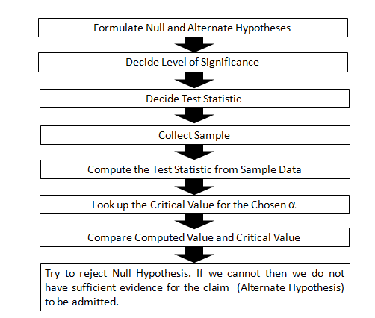
Hypothesis Testing Procedure

Slide 48
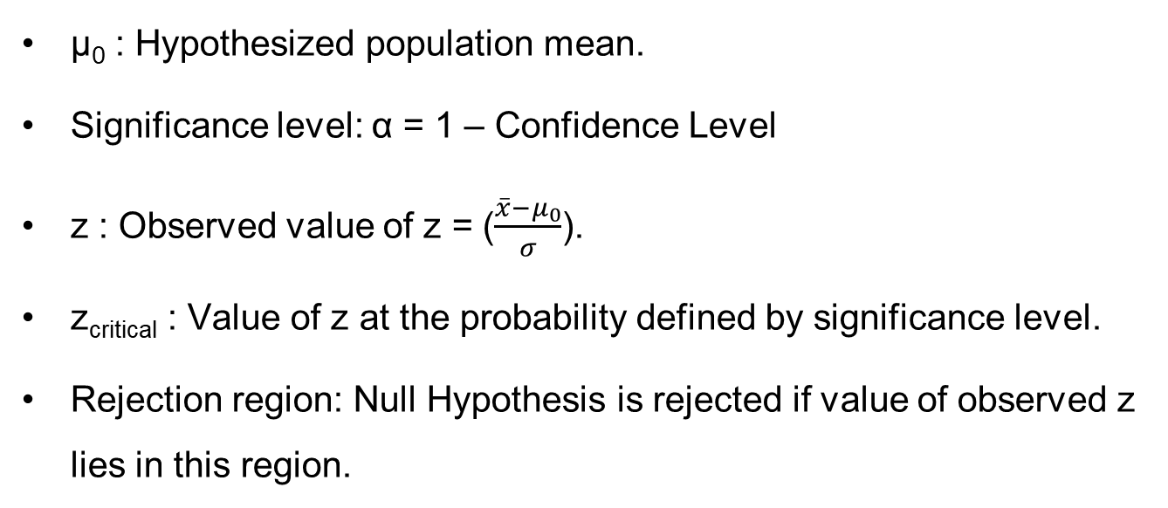
Hypothesis Testing Terminology:
µ₀ : Hypothesized population mean.
Significance level: α = 1 – Confidence Level
z : Observed value of z = ($\frac{\overline{x}−μ_{0}}{σ}$).
z_{critical} : Value of z at the probability defined by significance level.
Rejection region: Null Hypothesis is rejected if value of observed z lies in this region.

Slide 49
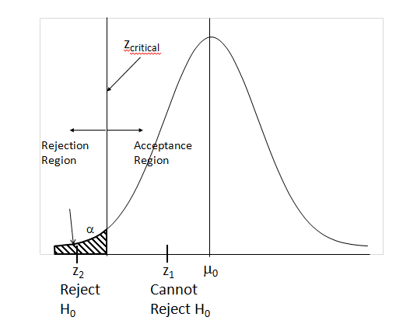
Hypothesis Testing – Identifying Rejection Region

Slide 50
Error
Hypothesis testing involves, collecting a sample and using it to estimate population mean.
It is always possible to land up with an outlier batch (sample) and make wrong estimation of the parameter.
In hypothesis testing, this means we wrongly reject Null Hypothesis since what we have an odd batch which is a rare occurrence (i.e. < 5%).
When this happen, we commit what is called type I error.
If we fix confidence level at 99%, we commit type I error 1% of times.

Slide 51
Type Errors
 |  | Population Condition
 |  | H₀ is True | H₀ is False
Conclusion | Accept H₀ | Correct Conclusion | Type II Error
 | Reject H₀ | Type I Error | Correct Conclusion
Type I Error is referred to as False Positive
Type II Error is referred to as False Negative

Slide 52
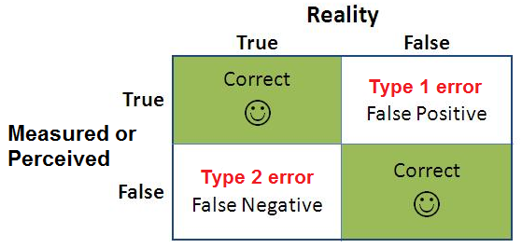
Types of Error

Slide 53
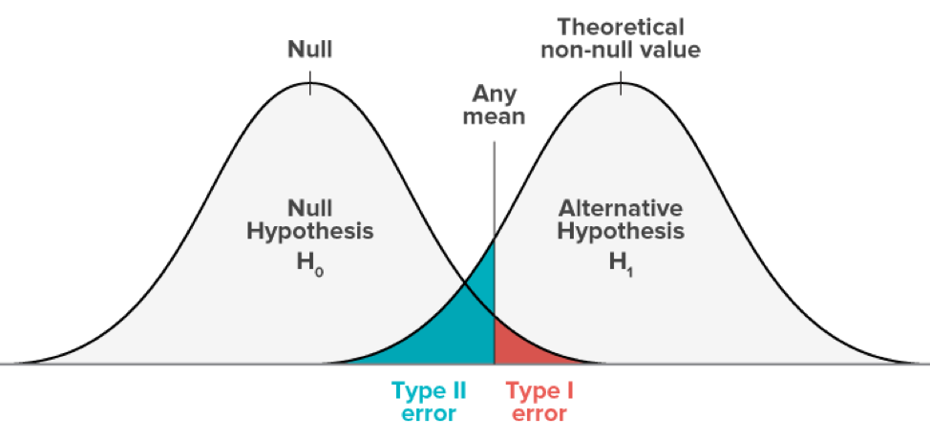
Understanding of Type I error
Type 1 errors are false positives
Happen in hypothesis testing when the null hypothesis is true, but we reject it.
A test with a 95% confidence level means that there is a 5% chance of getting a type 1 error.
Usually in a hypothesis test we only control type 1 error by specifying level of significance α.

Slide 54
Consequences of a Type 1 Error
Means that we wrongfully assume that the hypothesis is true when it is not..
In real life situations this means
Introduction of new technology which is not effective.
Admitting a claim when there is no deficiency of service.
Deploying resources when they are not needed.
Adjusting a process when the process is running fine.

Slide 55
Type I Error
Table showed that two kinds of error can be made
Incorrectly rejecting H₀ when it is true, is called type I error
Incorrectly accepting H₀ when it is false, is called type II error.
Type I error corresponds to admitting the claim when it reality it is wrong.
In practice the analyst tries to control the probability of this error by specifying confidence coefficient α.
Let 10 criminals escape but one innocent should not be punished.
Smaller the value of α more difficult it is to reject H₀ and less is the chance of committing type I error.
Therefore we have a high degree of confidence in stating that the claim is true when we select a low value for α.
The action required to process the claim is justified.

Slide 56
Understanding of Type II error
Type 2 error is referred as False Negative
Type 2 error occurs when the null hypothesis is false, and you fail to reject it.
If the probability of making a type 1 error is denoted by “α”, the probability of a type 2 error is denoted by “β”.
The quantity,1-β is called the power of the test, since it describes the probability of not committing a type 2 error.
There are 3 factors that can affect the power of a test:
Sample size (n)
The significance level of test (α)
The “true” value of your tested parameter.

Slide 57
Type II Error
In the foregoing argument, we implicitly assumed that we can ignore the consequence of committing the other type of error that is accepting H₀ when it is false.
In judicial system it is stated that “Let nine criminals escape but one innocent should not get punished”.
This is the same system we adopt in hypothesis testing that we are willing to control type I error while ignoring the magnitude of type II error.
In hypothesis testing parlance type I error is designated as α and type II error as β.
We can encounter situations where committing either type of error results in consequences that require management action. The following scenario illustrates this situation.

Slide 58

Business Case
A UPS manufacturer procures battery units from outside supplier for incorporating into his product. The inward quality control department carries out checks for quality before accepting the lot. Rejected lots are sent back resulting in shipping costs and possible effect on supplier relation if done frequently. On the other hand if a poor quality lot is accepted the end product’s quality will be affected resulting warranty claims, customer dissatisfaction and after-sales service load.
H_{o}: μ ≥ 120 H_{a}: μ < 120 | CL = 95% | α=0.05 | n = 36 | s = 12
We can calculate $\overline{x}$ at Z_{critical} above which the lot will be accepted.
$\overline{x}≥$ 120-1.645(12/$\sqrt{36)}=116.71$

Slide 59
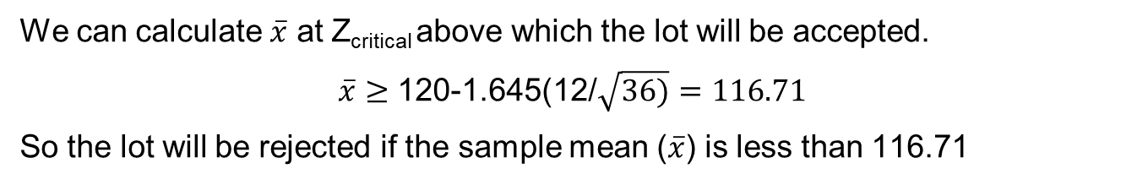
Calculating Type II Error Probability
A UPS manufacturer uses 120Ah battery in the production of UPS. He battery is sourced from a supplier. A batch of 36 batteries is tested and accepted at 95% confidence level.
To evaluate quality of incoming lot the company has set up a following inspection scheme. Design specifications require that acceptable capacity of the battery is 120Ah. The company formulated the following hypothesis test.
H_{o}: μ ≥ 120 H_{a}: μ < 120 | CL = 95% | α=0.05 | n = 36 | s = 12
We can calculate $\overline{x}$ at Z_{critical} above which the lot will be accepted.
$\overline{x}≥$ 120-1.645(12/$\sqrt{36)}=116.71$
So the lot will be rejected if the sample mean ($\overline{x}$) is less than 116.71

Slide 60
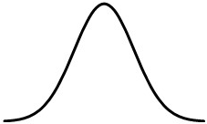

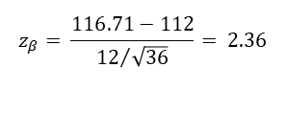

Probability of making type II error
Type II error is committed whenever we accept null hypothesis when it is in fact false.
For the case in hand a type II error is committed whenever μ < 120.
Probability of committing type II error is designated by β.
Let us calculate value of β when μ = say 112.
$$σ_{\overline{x}}=12/\sqrt{36}=2$$
$$z_{β}= \frac{116.71−112}{{12}/{\sqrt{36}}}= 2.36$$
β=.0093
$${2.36 σ}_{\overline{x}}$$
μ = 112

Slide 61
Probability of making type II error
From the above, when true μ is 112, the probability of making type II error is only 0.0093. The same way we can calculate β for various values of μ ranging from 112 to 120. This is shown in the table below:
μ | z | β | (1-β)
112 | 2.355 | .0093 | .9907
113 | 1.855 | .0318 | .9682
114 | 1.355 | .0877 | .9123
115 | 0.855 | .1963 | .8037
116 | 0.355 | .3613 | .6387
117 | -0.145 | .5576 | .4424
118 | -0.645 | .7405 | .2595
119 | -1.145 | .8739 | .1261
120 | -1.645 | .9500 | .0500

Slide 62
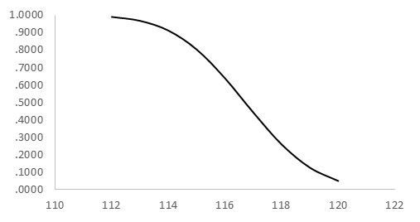
Probability of making type II error
Where μ is true population mean, β is probability of type II error and (1-β) is the probability of correctly rejecting null hypothesis and is called power of the test. The following graph which plots (1-β) at various values of μ is called power curve.
The power curve extends over the region where H₀ is false. The height of the curse indicates probability of correctly rejecting null hypothesis when it is false. As μ approaches hypothesized mean μ₀ the probability falls. In other words the probability of type II error increase as μ approaches μ₀.
POWER CURVE
Probability of correctly rejecting H₀
μ
H₀ False

Slide 63


Controlling type II error
Consider the following diagram which is a continuation of hypothesis test described above. In the one tail test discussed above the null and alternate hypotheses were of the type
H₀: μ ≥ μ₀
H_{a}: μ < μ₀
Sampling distribution of $\overline{x}$ when H₀ is true i.e.μ=μ₀
Reject H₀
α
μ₀
Sampling distribution of $\overline{x}$ when H₀ is false i.e.μ=μ_{a}
β
μ_{a}
c

Slide 64
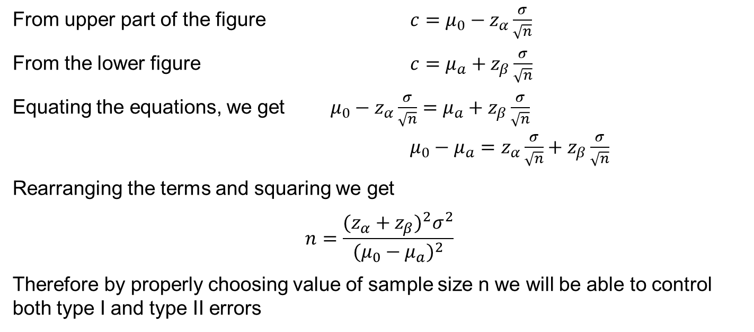
Controlling type II error
From upper part of the figure $c=μ_{0}−z_{α}\frac{σ}{\sqrt{n}}$
From the lower figure $c=μ_{a}+z_{β}\frac{σ}{\sqrt{n}}$
Equating the equations, we get $μ_{0}−z_{α}\frac{σ}{\sqrt{n}}=μ_{a}+z_{β}\frac{σ}{\sqrt{n}}$
$μ_{0}−μ_{a}=z_{α}\frac{σ}{\sqrt{n}}+z_{β}\frac{σ}{\sqrt{n}}$
Rearranging the terms and squaring we get
$$n=\frac{{(z_{α}+z_{β})}^{2}σ^{2}}{{(μ_{0}−μ_{a})}^{2}}$$
Therefore by properly choosing value of sample size n we will be able to control both type I and type II errors

Slide 65
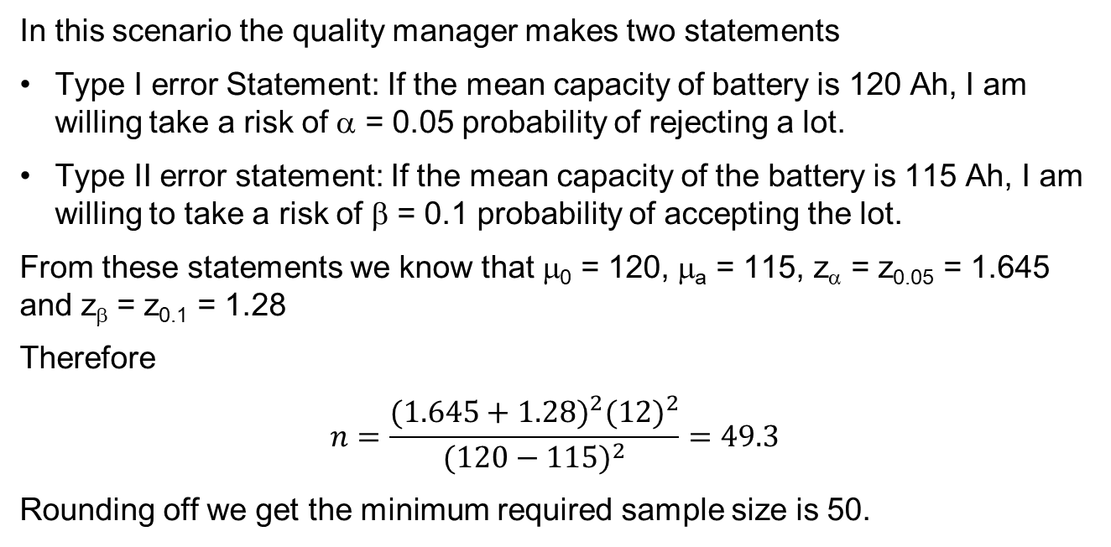
Illustration
In this scenario the quality manager makes two statements
Type I error Statement: If the mean capacity of battery is 120 Ah, I am willing take a risk of α = 0.05 probability of rejecting a lot.
Type II error statement: If the mean capacity of the battery is 115 Ah, I am willing to take a risk of β = 0.1 probability of accepting the lot.
From these statements we know that μ₀ = 120, μ_{a} = 115, z_{α} = z_{0.05} = 1.645 and z_{β} = z_{0.1} = 1.28
Therefore
$$n=\frac{{(1.645+1.28)}^{2}{(12)}^{2}}{{(120−115)}^{2}}=49.3$$
Rounding off we get the minimum required sample size is 50.

Slide 66
Number of Tails

Slide 67
One Tailed Test
One tailed tests are used, when it is required to test if observed mean significantly exceeds the hypothesized mean or when it is significantly lesser than the hypothesized mean.
The one-tailed test provides more power to detect an effect in one direction by not testing the effect in the other direction.
Two possibilities:
Right tailed test is when inequality of Alternate Hypothesis points to the right (a > symbol).
Left tailed test is when inequality of Alternate hypothesis statement points to the left(a < symbol).

Slide 68
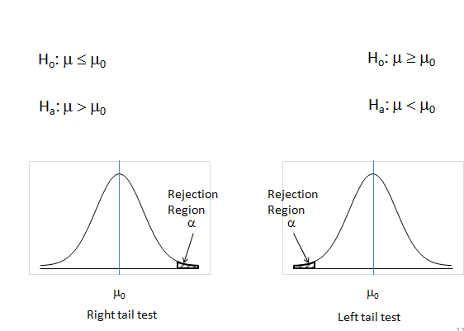
One Tail Tests

Slide 69
Left Tail Test
A consumer forum suspects that 300 gm pack of Narasu’s Coffee, is underweight. The forum wants to check this by collecting a sample and using a 0.05 level of significance.
H_{o}: μ ≥ 300(μ₀)
H_{a}: μ < 300(μ₀)

Slide 70
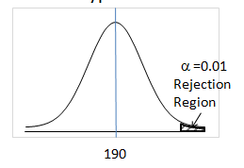
Right Tail Test
The Food Administration Authority received complaints that Maggi Noodle pack contains lead beyond permissible limits. The amount of lead should not exceed 190 gm. Conduct the Hypothesis test.
H_{o}: μ ≤ 190(μ₀)
H_{a}: μ > 190(μ₀)

Slide 71
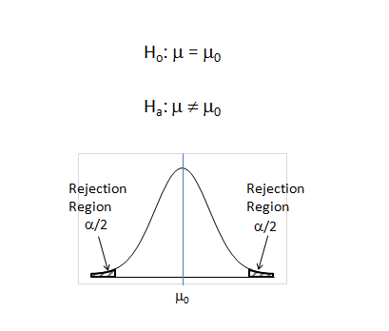
Two Tail Test
Notice that α is split into 2 halves and applied equally on right and left sides. Therefore at the same significance level it is more difficult to reject null hypothesis in a two-tailed test.

Slide 72
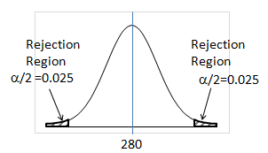
Two Tail Test - Example
The weight of a drug has to be critically controlled. If less, the drug may not be effective, if more it may have some side effects. The manufacturer of the drug wants ascertain that the weight of the capsule is 280 mg at 95% confidence.
H_{o}: μ = 280(μ₀)
H_{a}: μ ≠ 280(μ₀)

Slide 73
Choice of Test Statistic

Slide 74
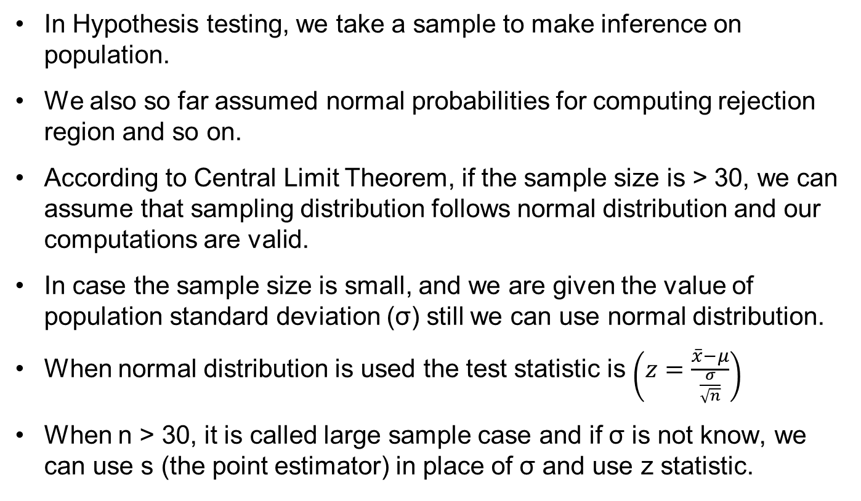
Choice of Test Statistic
In Hypothesis testing, we take a sample to make inference on population.
We also so far assumed normal probabilities for computing rejection region and so on.
According to Central Limit Theorem, if the sample size is > 30, we can assume that sampling distribution follows normal distribution and our computations are valid.
In case the sample size is small, and we are given the value of population standard deviation (σ) still we can use normal distribution.
When normal distribution is used the test statistic is $\left(z=\frac{\overline{x}−μ}{\frac{σ}{\sqrt{n}}}\right)$
When n > 30, it is called large sample case and if σ is not know, we can use s (the point estimator) in place of σ and use z statistic.

Slide 75
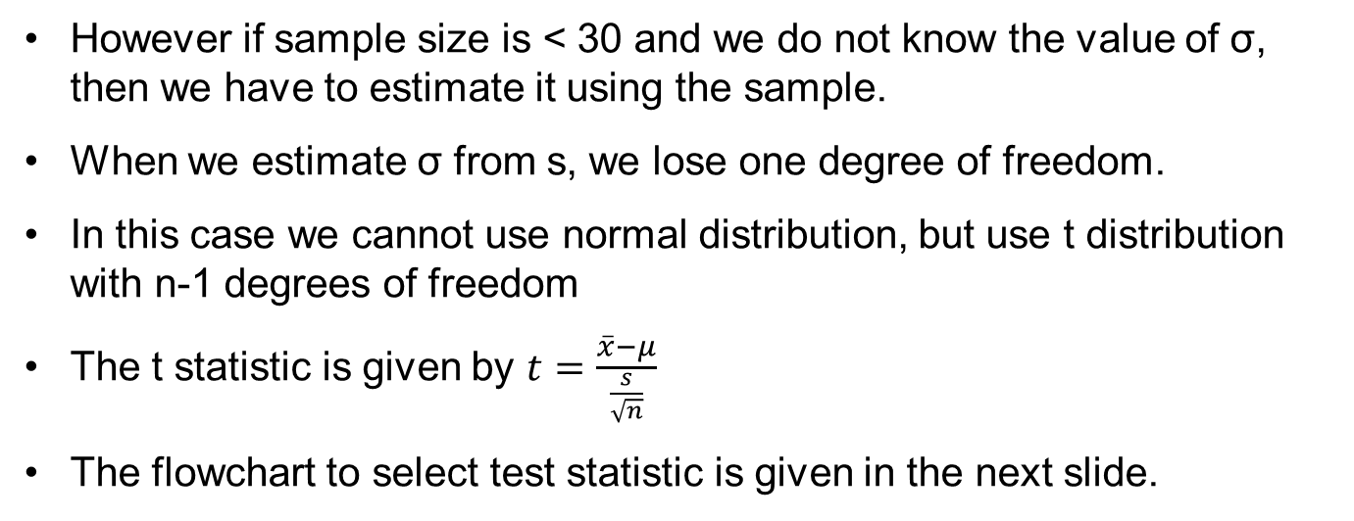
Choice of Test Statistic - Continued
However if sample size is < 30 and we do not know the value of σ, then we have to estimate it using the sample.
When we estimate σ from s, we lose one degree of freedom.
In this case we cannot use normal distribution, but use t distribution with n-1 degrees of freedom
The t statistic is given by $t=\frac{\overline{x}−μ}{\frac{s}{\sqrt{n}}}$
The flowchart to select test statistic is given in the next slide.

Slide 76
Hypothesis Testing Procedure
Is n >= 30?
Yes
No
Is population normal?
Is σ known?
Yes
No
Yes
No
Is σ known?
Yes
No
Use the s to estimate σ
Use the s to estimate σ
Use
Use
Use
Use
Increase sample size to 30

